Slide 1
# Systems

Slide 2
Decimal is Base 10
Ten digits: 0123456789
Why is 9047 nine thousand forty seven?
Example digits: |  | 9 | 0 | 4 | 7
Place values: 10^{n} |  | 1000 | 100 | 10 | 1
Powers of ten: 10^{n} |  | 10³ | 10² | 10¹ | 10⁰
Value |  | 9000 | 0 | 40 | 7

Slide 3
Binary is Base 2
Two digits: 0 and 1
Why is 1011 eleven?
Example digits: |  | 1 | 0 | 1 | 1
Place values: 2^{n} |  | 8 | 4 | 2 | 1
Powers of two: 2^{n} |  | 2³ | 2² | 2¹ | 2⁰
Value |  | 8 | 0 | 2 | 1

Slide 4
Hexadecimal is Base 16
Sixteen digits: 0123456789ABCDEF
Why is 3A fifty eight?
Example digits: |  | 2 | F | 3 | A
Place values: 16^{n} | 65536 | 4096 | 256 | 16 | 1
Powers of sixteen: 16^{n} | 16⁴ | 16³ | 16² | 16¹ | 16⁰
Value |  | 8192 | 3840 | 48 | 10

Slide 5
Bit vs. Byte
Bit – single piece of information
Byte – 8 bits of information
Base 2 – Comprised of 2 discrete values
Easily converted to hexadecimal
Need to do more than just calculations
Windows, Java, etc., moved to 16-bit characters long ago.

Slide 6
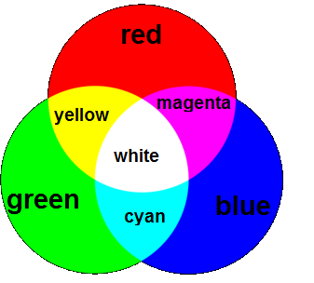
Color = RGB
Three numbers (typically each a byte, 0 to 255) for red, blue, and green brightness

Slide 7
Color = RGB
Primary Colors: Red (255, 0, 0)
Green (0, 255, 0)
Blue (0, 0, 255)

Slide 8
Color = RGB
Secondary Colors: Magenta (255, 0, 255)
Cyan (0, 255, 255)
Yellow (255, 255, 0)
Notes:
Used primarily in printing

